Slide 1


4. Final Testing and
Reporting

Slide 2
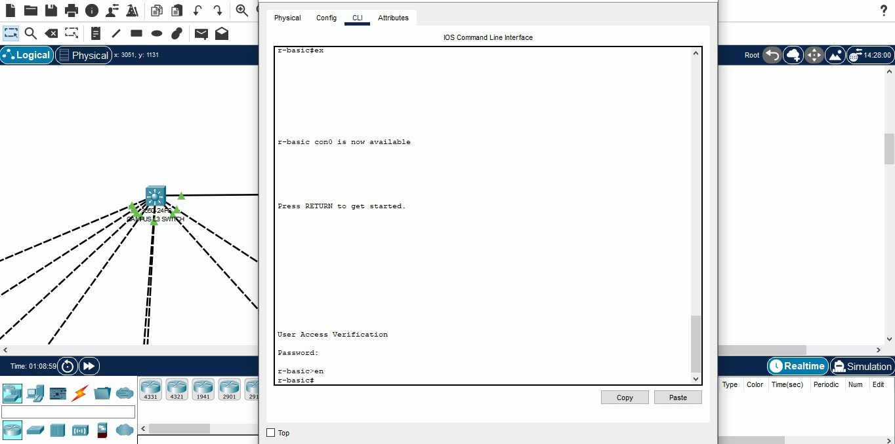
ACL Configuration

Slide 3
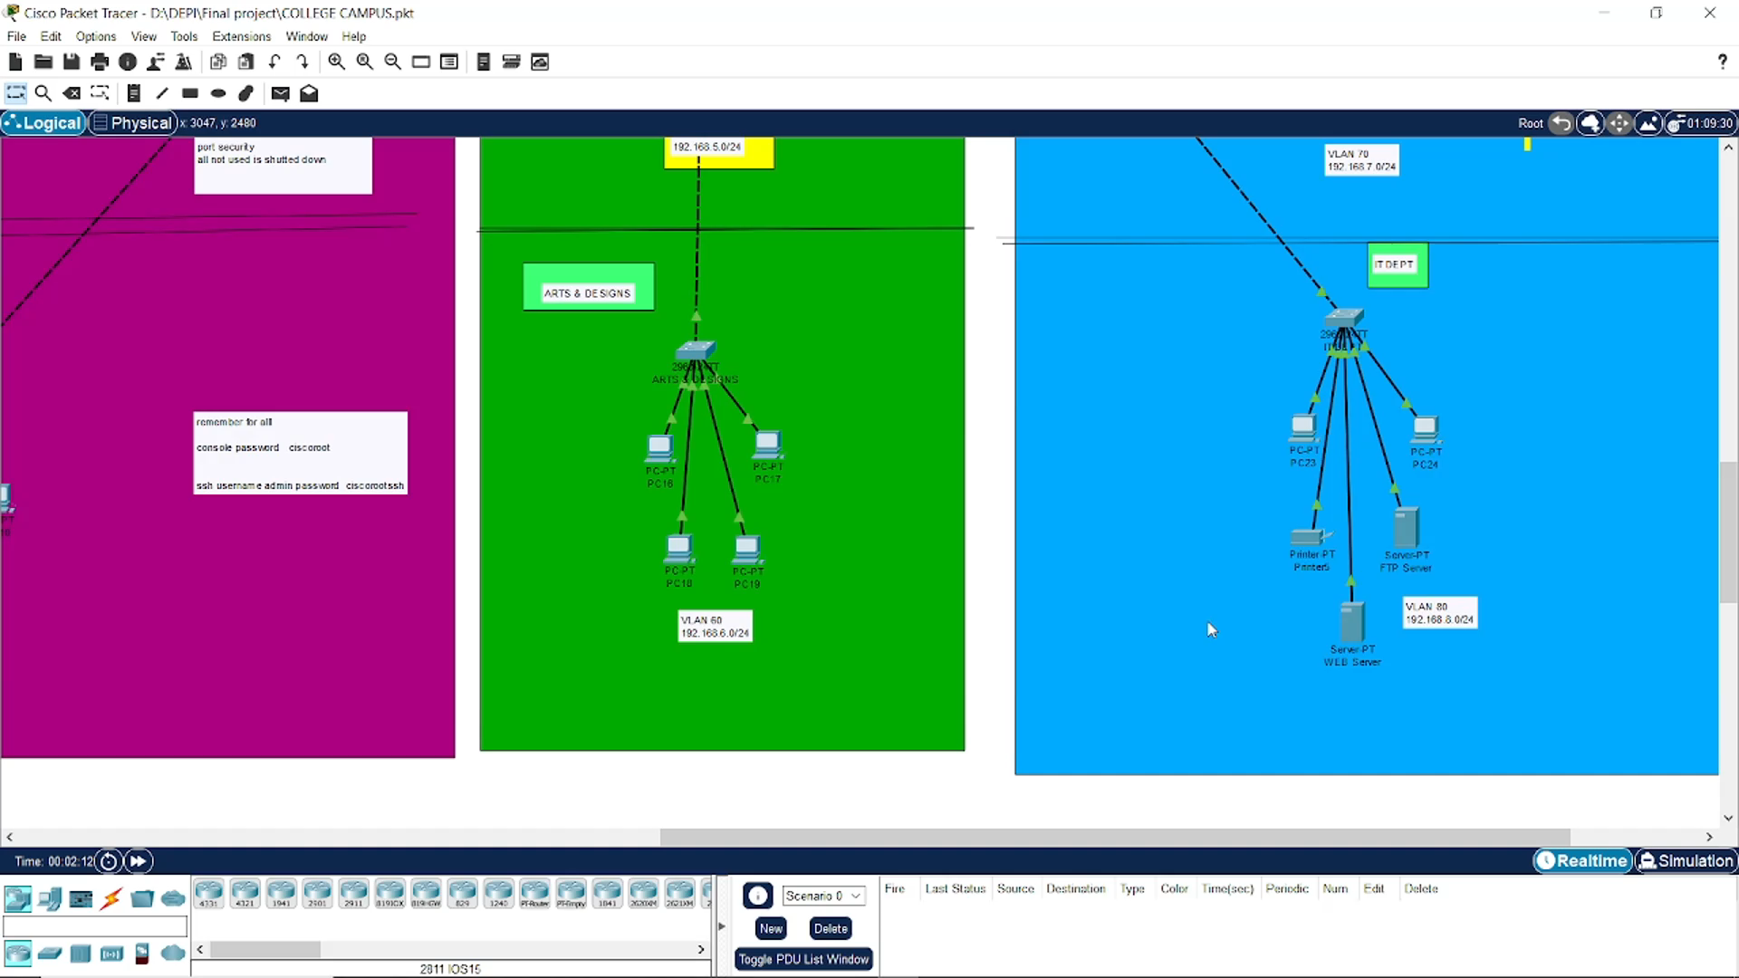
ACL Testing:

